Slide 1
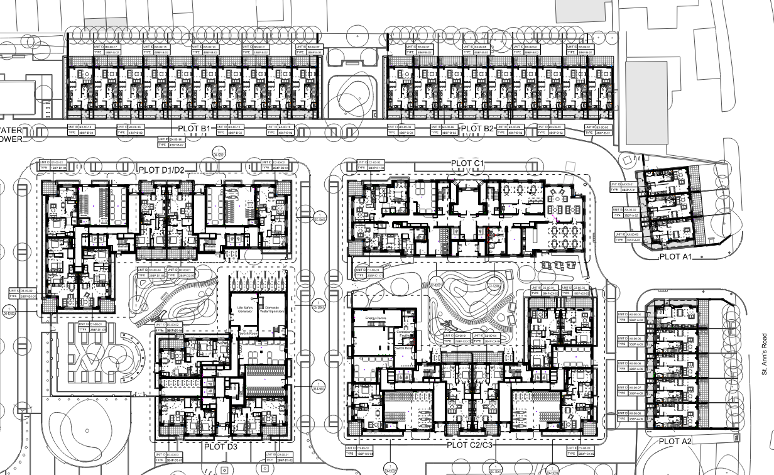
X026 – St Anns Landscape Presentation –
B1 & B2 Houses

Slide 2
X026 – St Anns Landscape Presentation
Condition 55
Notwithstanding the details submitted as part of the application, three months prior to the beginning of relevant works in Phase 1A, full details of hard and soft landscaping shall be submitted to and approved in writing by the Local Planning Authority. The details shall include:
i) Hard surfacing materials; (Refer to slides 3, 4 & 5).
ii) Children’s play areas and equipment – There are no Children’s play areas or equipment applicable to plot B1 or B2 houses.
iii) Boundary treatments; (Refer to slides 6, 7, 8 & 9).
iv) Any relevant SUDs features and associated SUDS management and maintenance plans, detailing future management and maintenance responsibilities for the lifetime of the development. - Please note that SUDs features were submitted in a separate planning condition (Condition 36) which has been discharged.
v) Minor artefacts/structures (e.g. furniture, refuse or other storage units, signs etc.); (Refer to slides 9 & 10).
vi) Proposed and existing functional services above and below ground (e.g. drainage power, communications cables, pipelines etc. indicating lines, manholes, supports etc.); (Refer to slide 11).
vii) Planting plans and a full schedule of species of new trees and shrubs proposed to be planted noting species, plant sizes and proposed numbers/densities where appropriate; (Refer to slide 12).
viii) If T47 black mulberry is damaged during construction and associated works and needs to be removed this shall be replaced with a high quality tree of an appropriate size, standard and species; - T47 has been protected from the site works and currently not damaged. This is also outside of Plot B curtilage.
ix) Written specifications (including cultivation and other operations) associated with plant and grass establishment; and (Refer to slide 12).
x) Implementation programme. - The landscape works are currently ongoing on site and due to complete by WC 23.02.26.
xi) Long term management
xii) Full details of wayfinding signage including their location, material and mounting (developed in consultation with the Council’s Regeneration team); - No wayfinding signage required for the houses.
xiii) details of short stay parking to be provided in accordance with the London Cycle Design Standards. (Refer to slide 13).
xiv) existing and proposed land levels. (Refer to slide 14).
* Items ii, iv, viii, x & xii are not included in this presentation as they are not applicable for B1 & B2 houses, for reasons explained above in red.

Slide 3
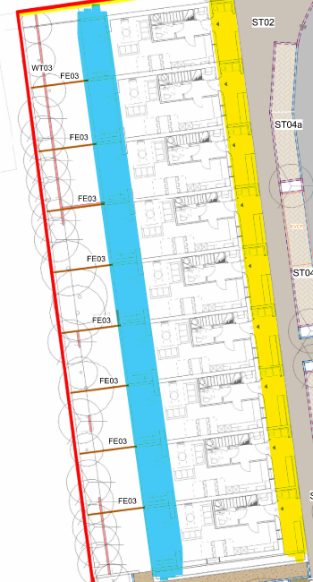
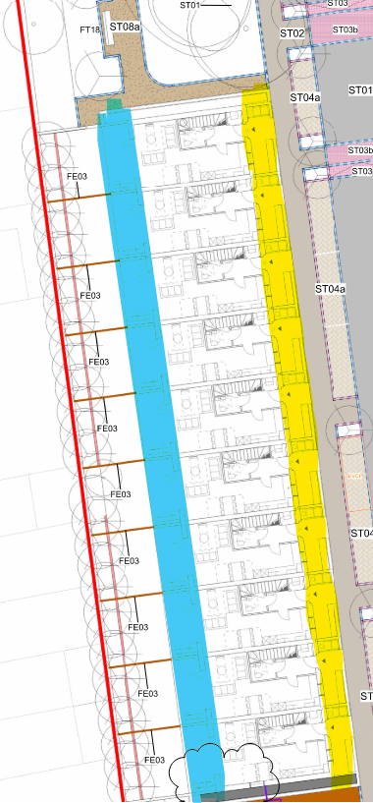

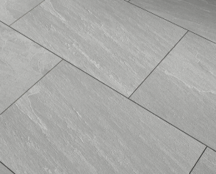
i) Hard surfacing materials – Front & Back of house Paving
Front of House Paving |  | Herringbone | Concrete Block Kilsaran Inish natural concrete block pavers. 200x100x65mm.
Back of House Paving |  | Stack Bond | Brett Eclipse Grande porceline tiles, kandla grey 900x600X20MM.

Slide 4
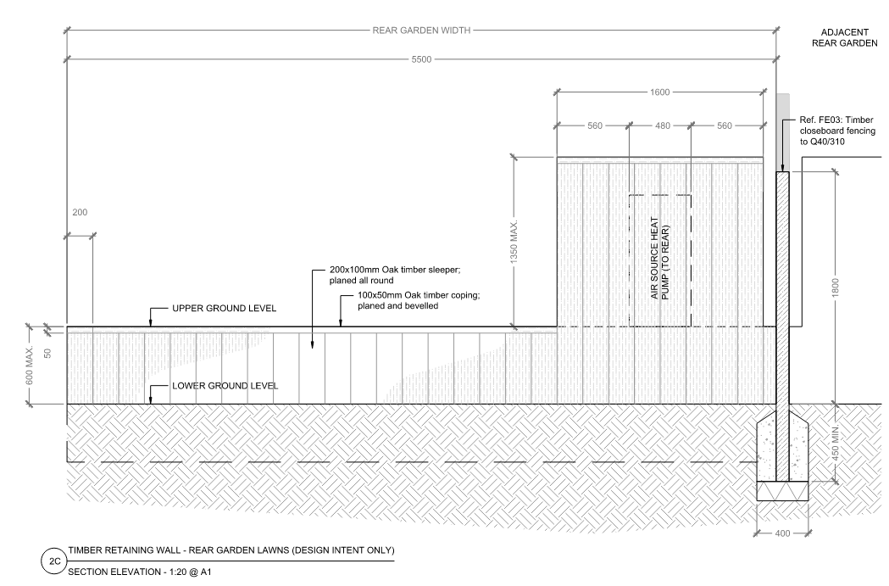

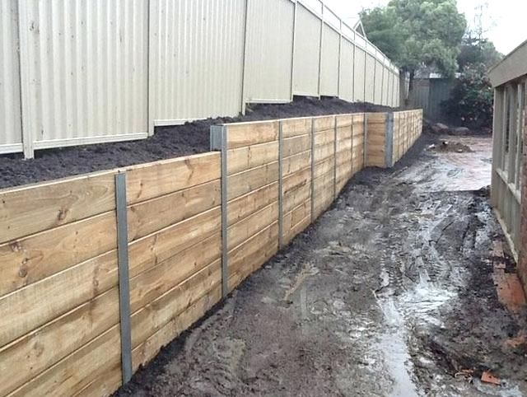
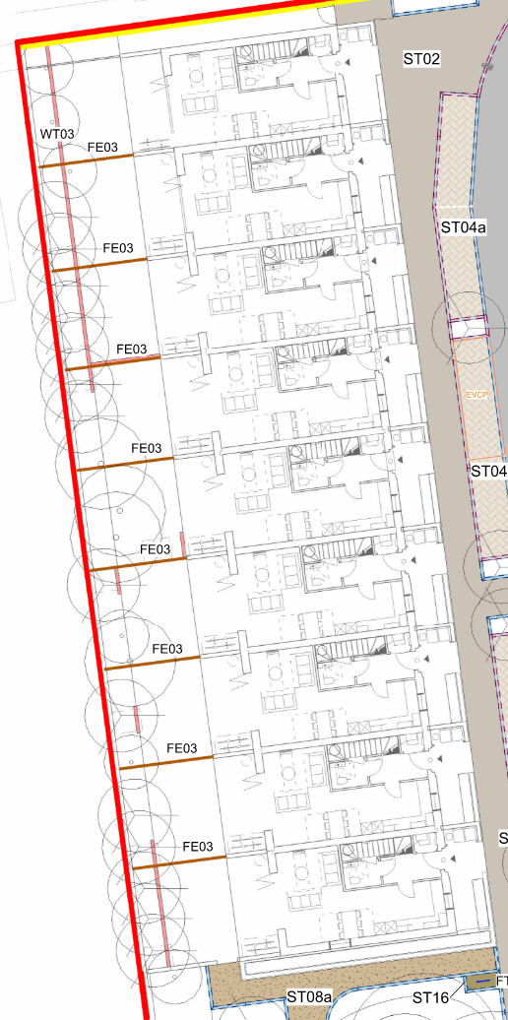
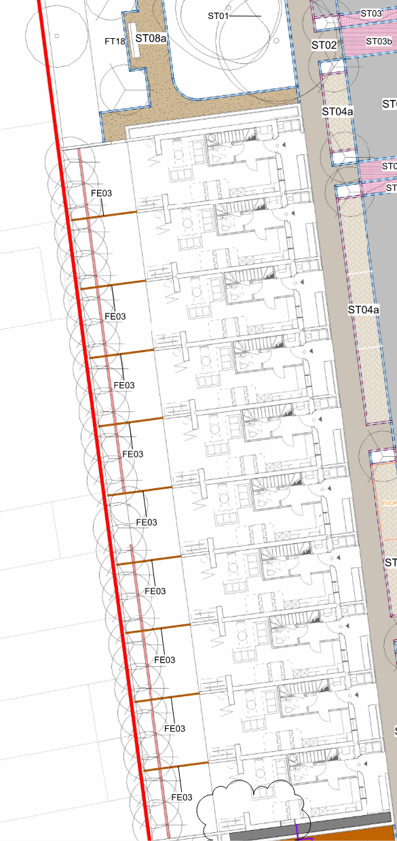
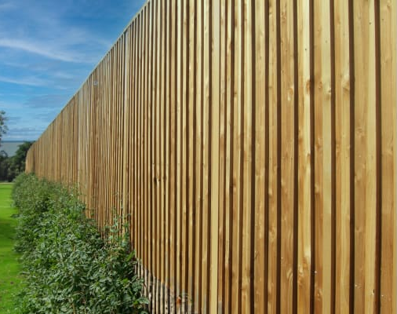

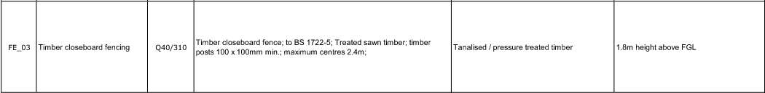
iii) Hard surfacing materials / Boundary Treatments – Timber Fence in back gardens
‘N15301-PLI-XX-ZZ-DR-L-60232’ – Typical Details – Sheet 2 Retaining Walls.

Slide 5
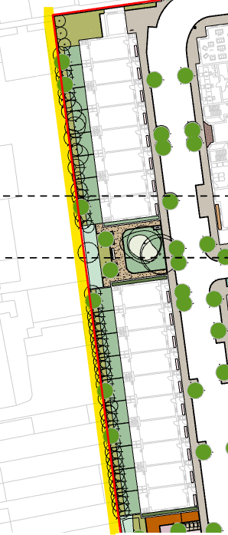
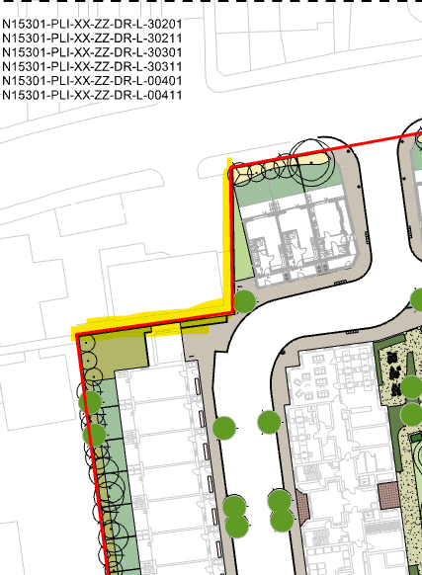
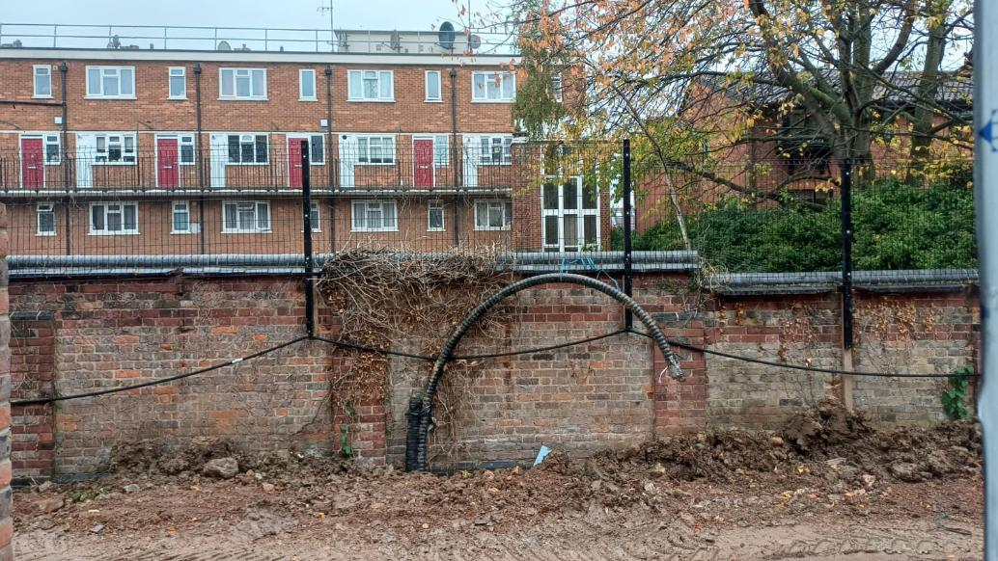
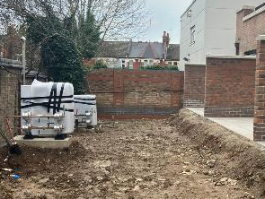
iii) Boundary treatments – Boundary Wall in back gardens
Existing Wall
New Boundary Wall
Notes:
KT01 – 125mm upstands
KT02 – Flush
KT03 – Flush
KT04 – 25mm Upstand

Slide 6
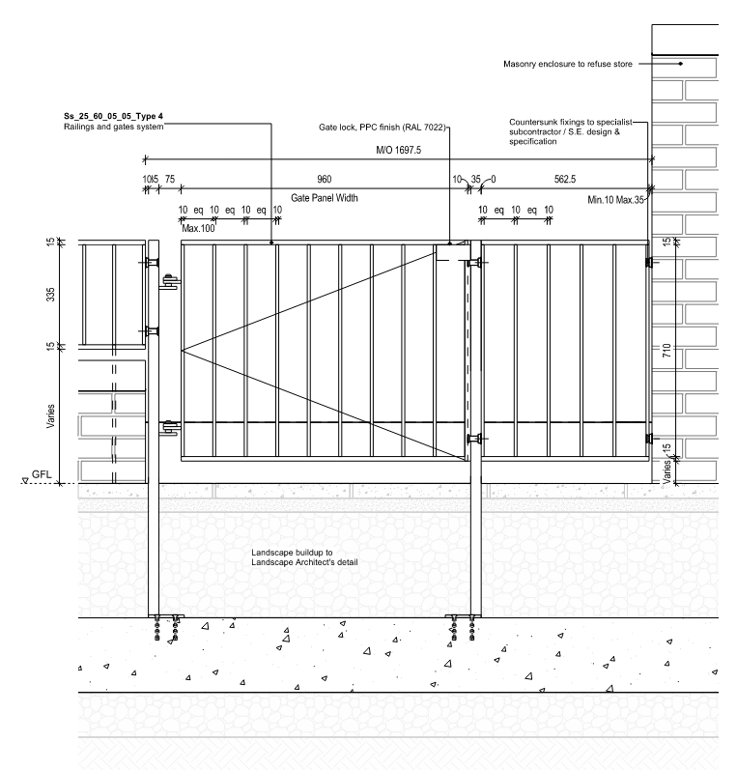
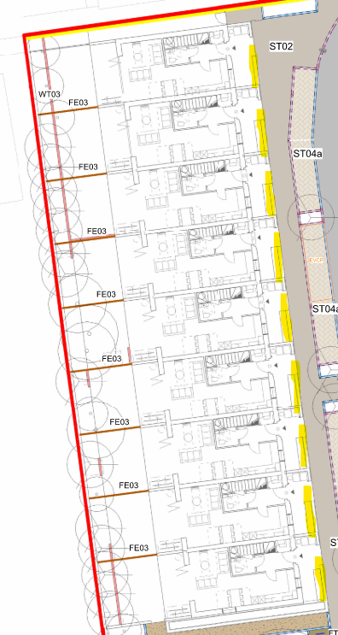
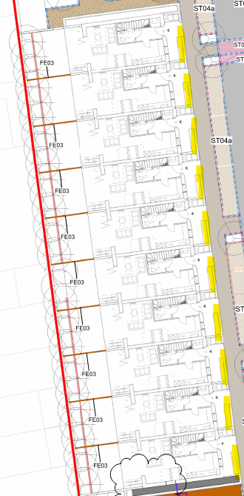
iii) Boundary Treatments – Front Boundary Walls
‘N15301-KCA-ZZ-ZZ-DR-A-55103’ – Metalwork Details: Sheet 4 – Plot A & B Patio Gate & Railing Fixing.

Slide 7
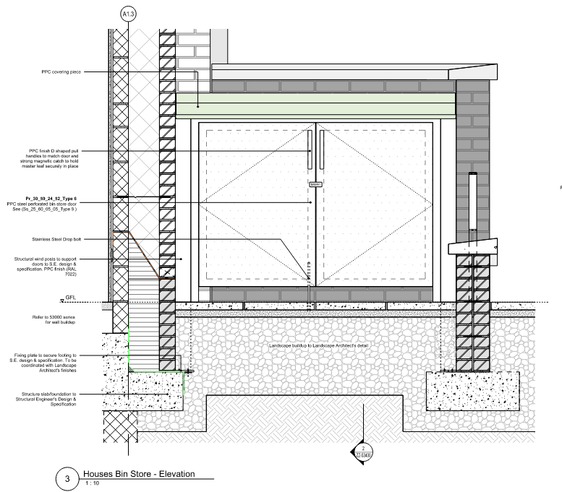
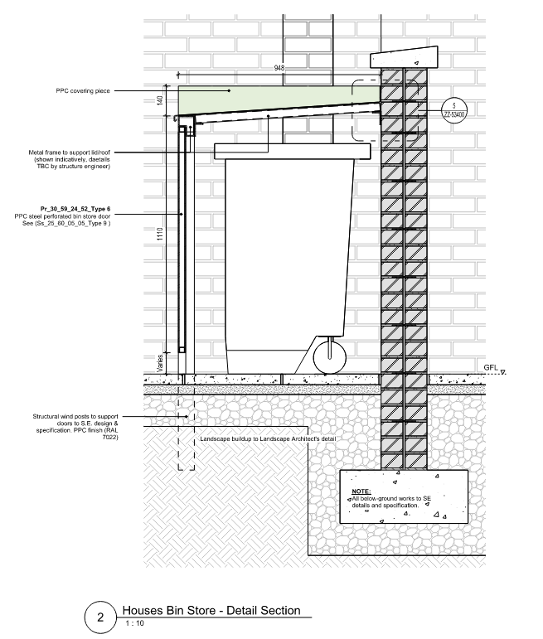
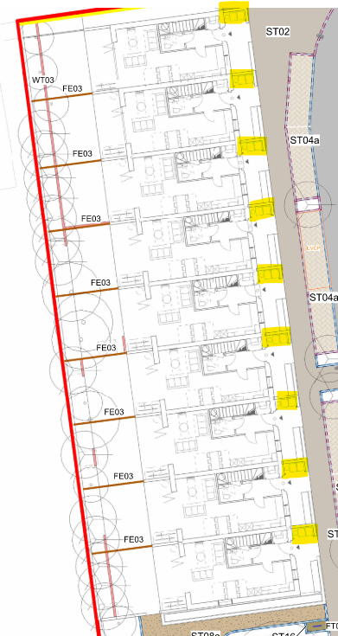
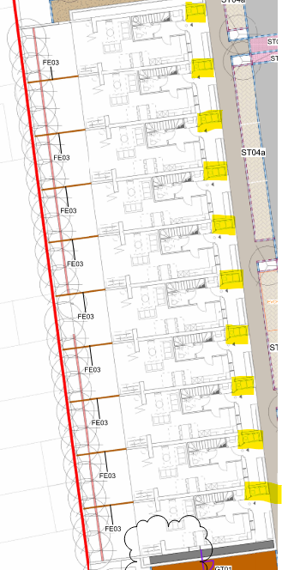
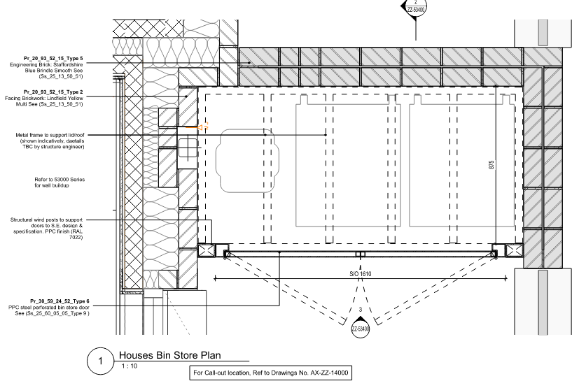
iii) Boundary Treatments / v) Minor Artefacts/Structures
– Bin Store (Front Garden)
Bin Store – Front Garden
‘N15301-KCA-ZZ-ZZ-DR-A-53400’ – External Additional Details: Sheet 1 Plot A & B Bin Store Details.
Notes:
KT01 – 125mm upstands
KT02 – Flush
KT03 – Flush
KT04 – 25mm Upstand

Slide 8
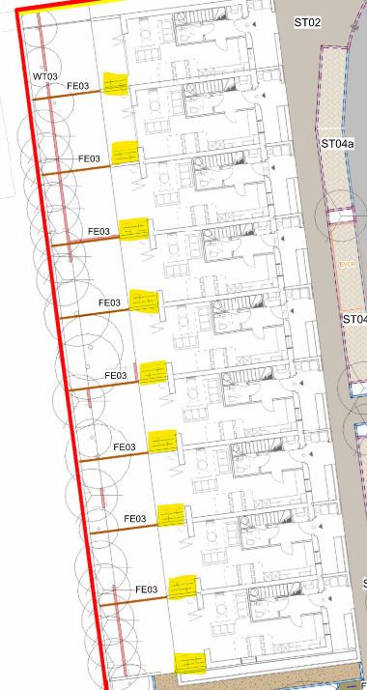
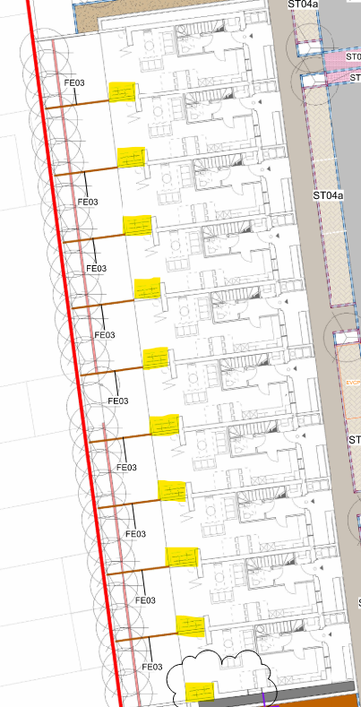
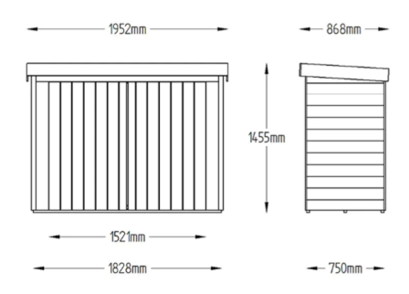
v) Minor Artefacts/Structures –Bike Store Allocation
Bike allocation to back gardens
‘Bike store spec’.
Notes:
KT01 – 125mm upstands
KT02 – Flush
KT03 – Flush
KT04 – 25mm Upstand

Slide 9
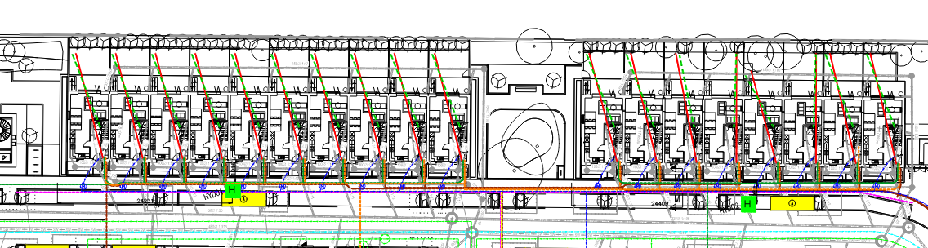
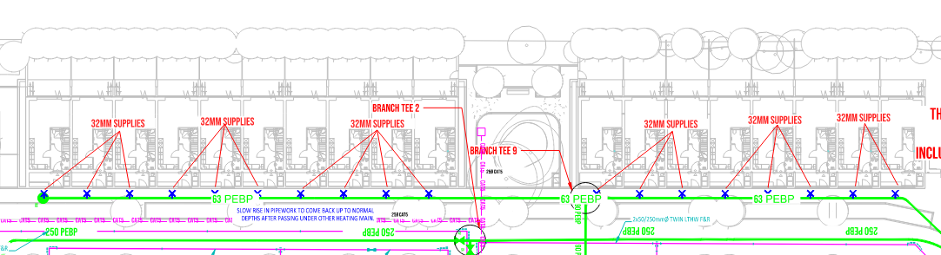
vi) Proposed and Existing Functional Services
No existing services will be kept, therefore only proposed services designs have been submitted:
‘N15301-RBE-ZZ-00-DR-E-06001’ – Site External Duct Layout.
‘N15301-DDS-ZZ-ZZ-DR-M-1051’ – External Services Layout.
Notes:
KT01 – 125mm upstands
KT02 – Flush
KT03 – Flush
KT04 – 25mm Upstand

Slide 10
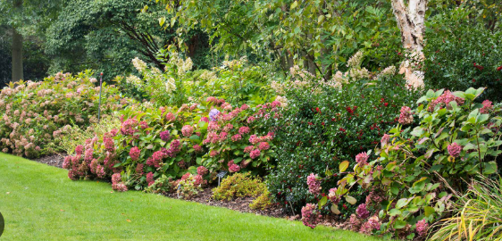
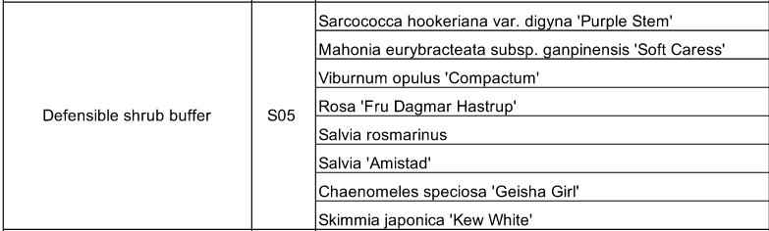
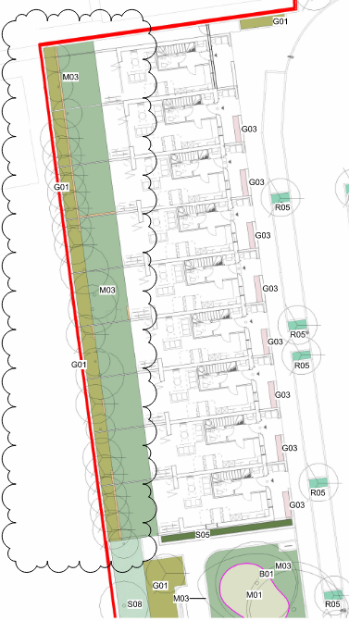
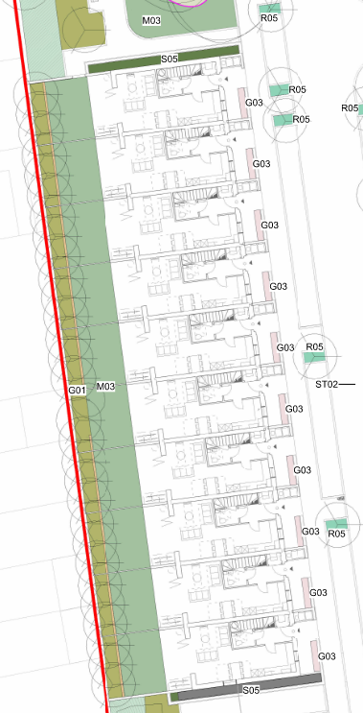

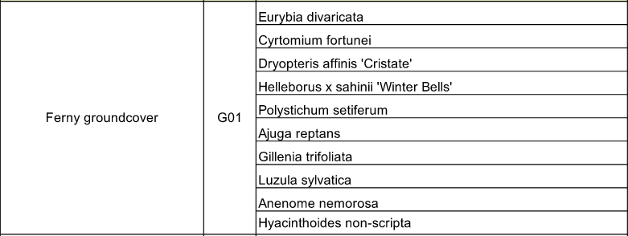
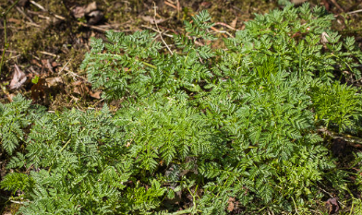

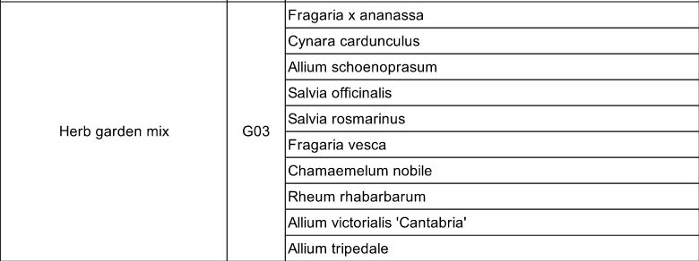

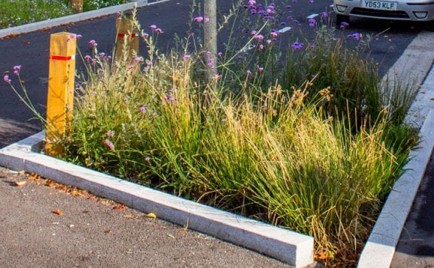

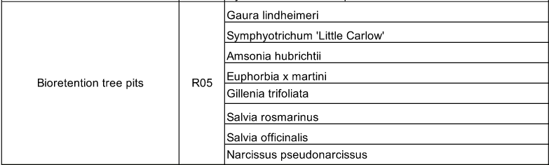
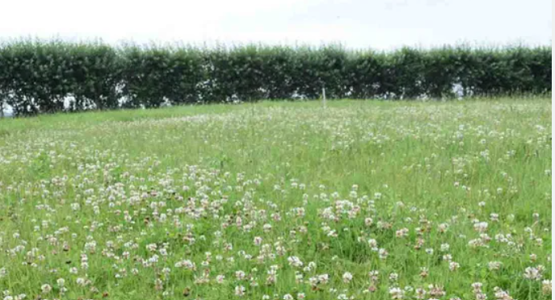

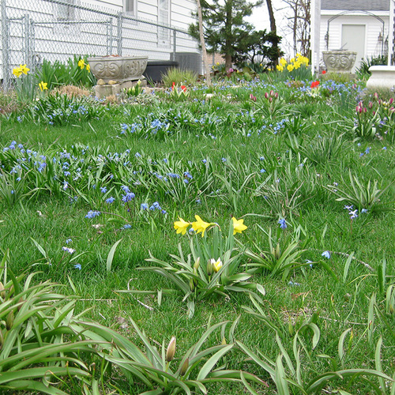


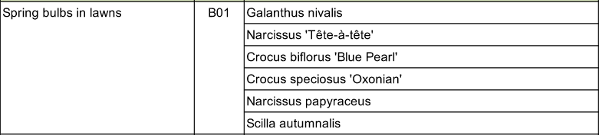
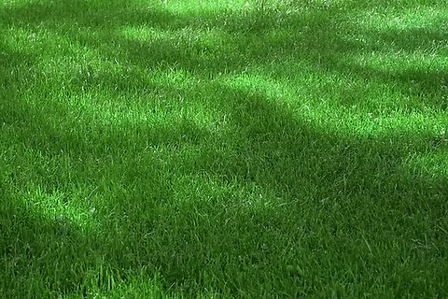


vii, ix) – Private Gardens to Houses
S05
G01
B01
M03
Notes:
KT01 – 125mm upstands
KT02 – Flush
KT03 – Flush
KT04 – 25mm Upstand

Slide 11
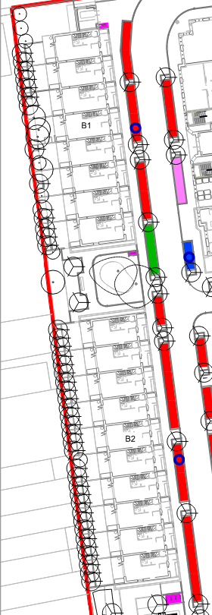
xiv) Short Stay Parking
Plot B1 & B2 parking area extracted from drawing: ‘N15301-PLI-XX-ZZ-DR-L-10111’
Notes:
KT01 – 125mm upstands
KT02 – Flush
KT03 – Flush
KT04 – 25mm Upstand

Slide 12
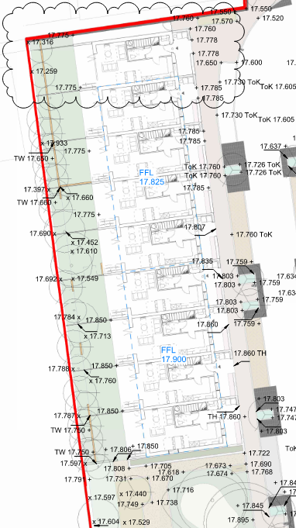
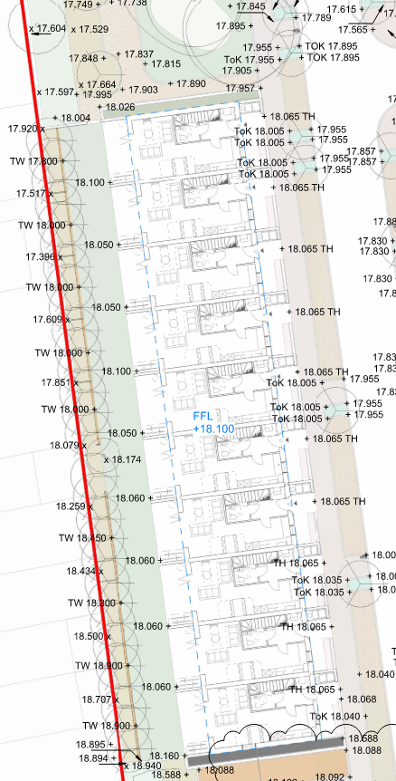
xiv) Existing and Proposed Land Levels
Existing levels are shown on the topographic surveys submitted at planning stage.
Proposed Levels:
‘N15301-PLI-XX-ZZ-DR-L-00401’
‘N15301-PLI-XX-ZZ-DR-L-00404’
Notes:
KT01 – 125mm upstands
KT02 – Flush
KT03 – Flush
KT04 – 25mm Upstand

