Slide 1
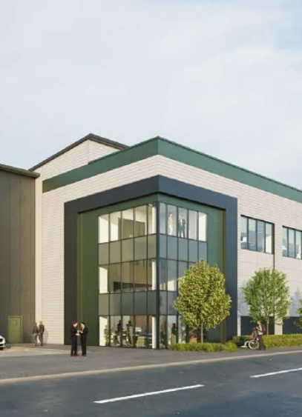







Travel Planning Tools
Train Travel
Walking
TRAVEL
PACK
Cycling
Unit 1 -
No.18 West Road
Bus Routes
Car Sharing
Information Correct as of January 2026

Slide 2
Introduction
The aim of the Travel Plan is to provide long-term change in travel habits towards sustainable travel modes.
The Travel Plan will be updated so your feedback to our travel surveys is greatly appreciated.
This Travel Pack has been prepared for the staff to raise awareness of active travel and public transport opportunities.
Health Benefits
Walking and cycling can significantly improve physical and mental health and is a convenient way to incorporate exercise into your daily routine.
Cost Benefits
Using public transport can be significantly cheaper than car use- removing the cost of both running and servicing a vehicle.
Environmental Benefits
Increasing public transport use and active travel is key to the governments sustainable transport strategy.

Slide 3



Objectives and Targets
Objectives:
This Travel Plan has the following objectives:
To reduce the traffic generated by the warehouse
To influence the travel behaviour of staff
To reduce the need for unnecessary journeys by private vehicles
To improve the health and wellbeing of staff
Targets:
Targets help us to understand if objectives have been achieved.
Cycling:
By +7%
Car use:
By -10%
Walking:
By +3%

Slide 4
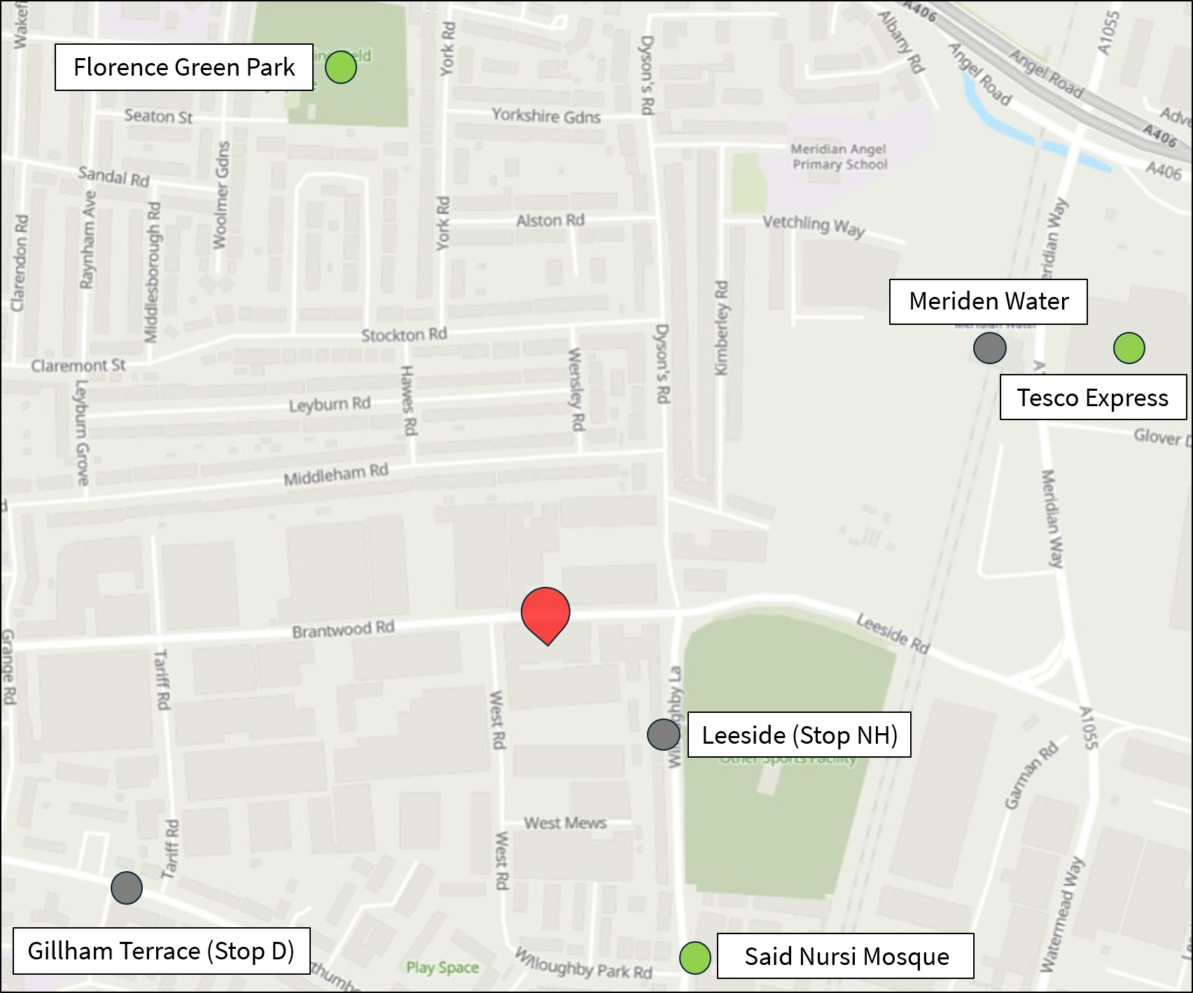



Walking in the Area
Local Walking Routes:
Said Nursi Mosque 480m 6-minute walk
Tesco Extra 960m 12-minute walk
Florence Green Park 965m 12-minute walk
Leeside Road (NH) 320m 4-minute walk
Gillham Terrace (D) 480m 6-minute walk
Meridian Water 640m 8-minute walk

Slide 5
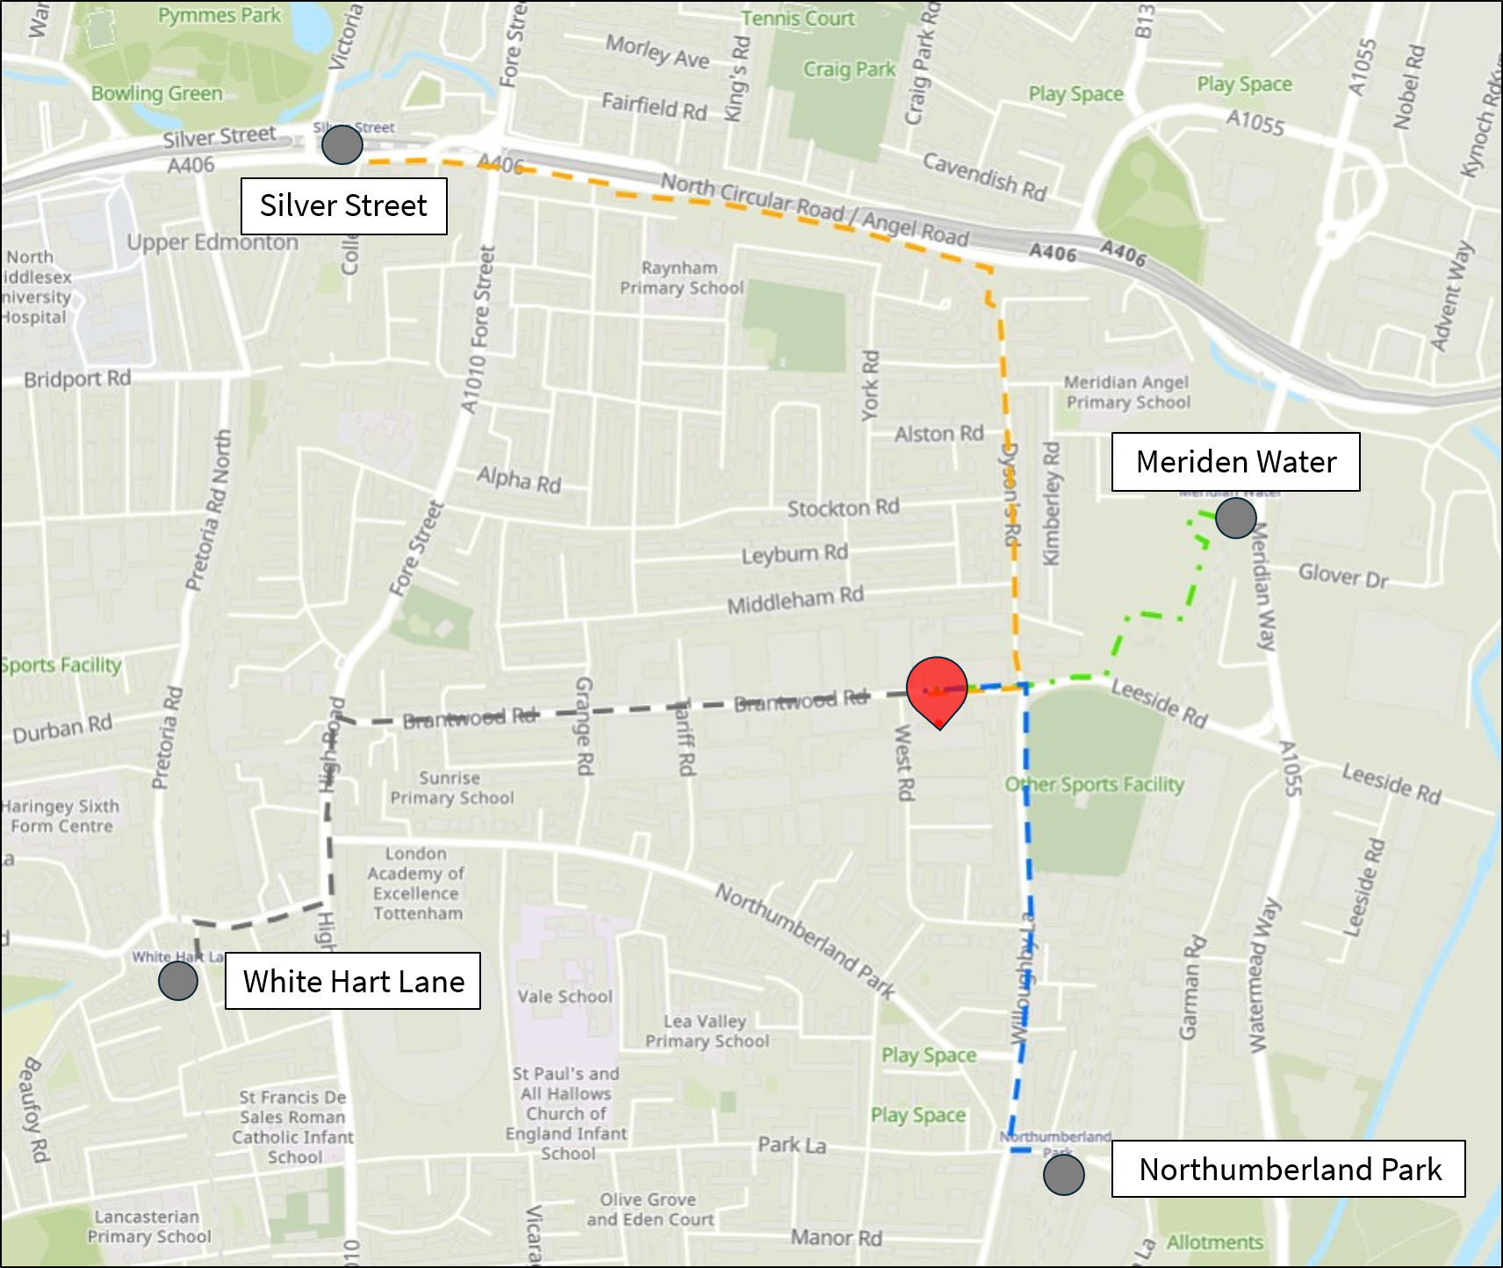
Walk the Last Kilometre
Local Walking Routes:
A great way to get more walking into your day is to walk for the last leg of your journey, either by getting off a station early or walking from the nearest main transport hub instead of using public transport.
The map above shows the stations within walking distance of the warehouse and potential walking routes.
Not only is walking free, but it is also the most environmentally friendly mode of transport and a convenient way to take exercise as part of your day.

Slide 6
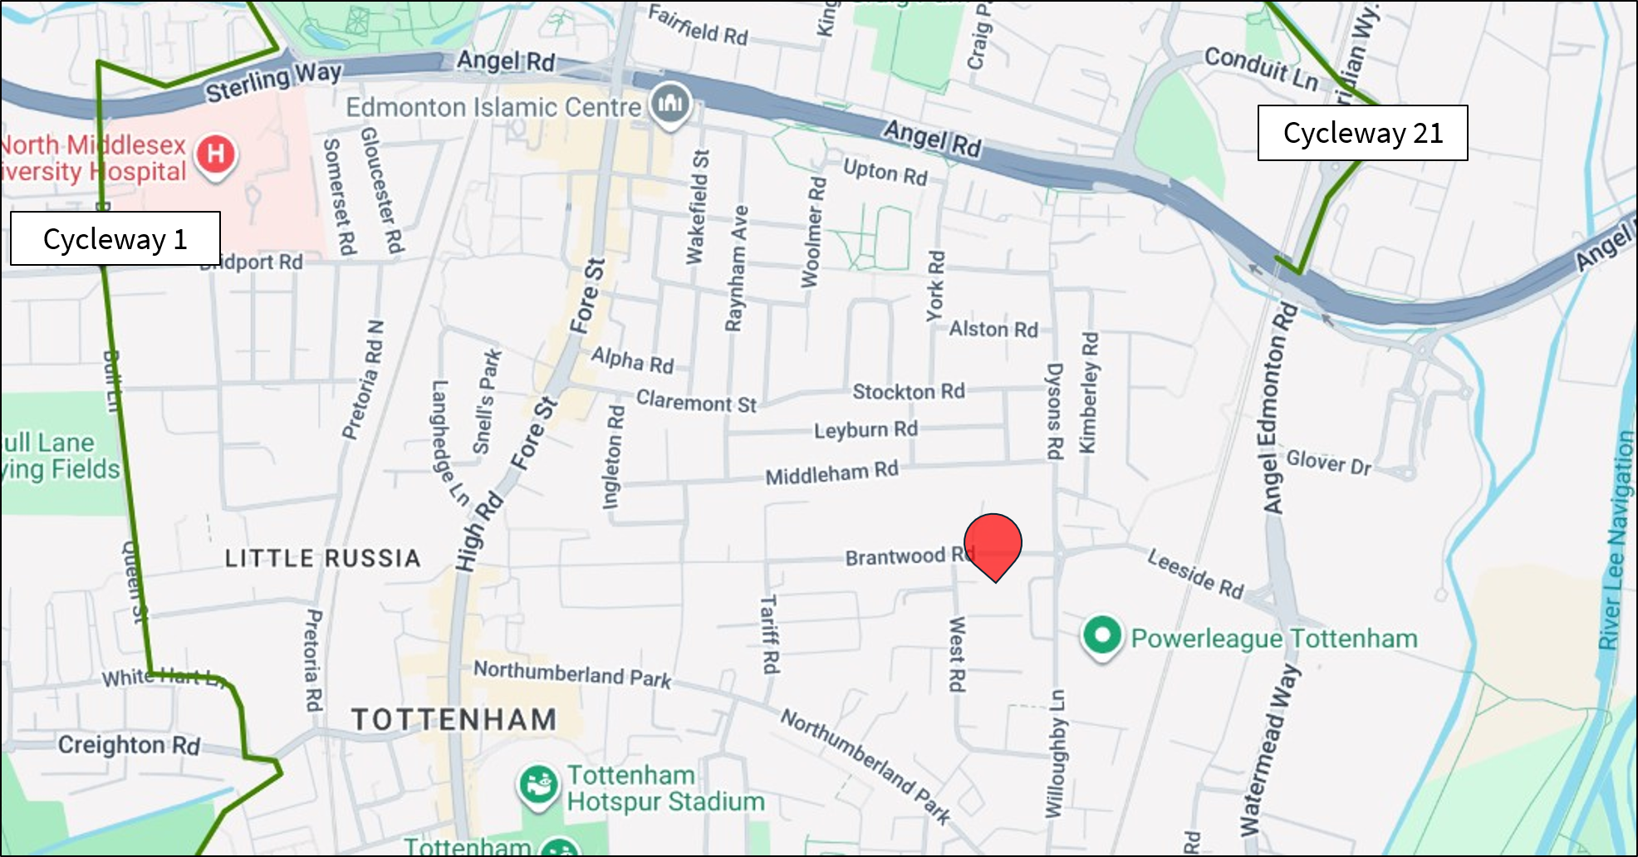

Cycling in the Area
Palmers Green:
14-minute cycle away
Turnpike Lane:
12-minute cycle away
Seven Sisters:
11-minute cycle away
Local Cycling Routes:
The TfL Cycle Map can be used to find quiet and quick cycling routes between destinations; your local route is routes are 1 ( Freezy Water – The City) and 21 ( Bush Hill – Meridian Water).
The TfL Go App facilitates cycle route planning in London; users can choose between easy, moderate or fast journeys to match their needs.
Remember:
Lock your bike (frame and wheels) to a solid, fixed object and always lock the cycle store behind you.

Slide 7
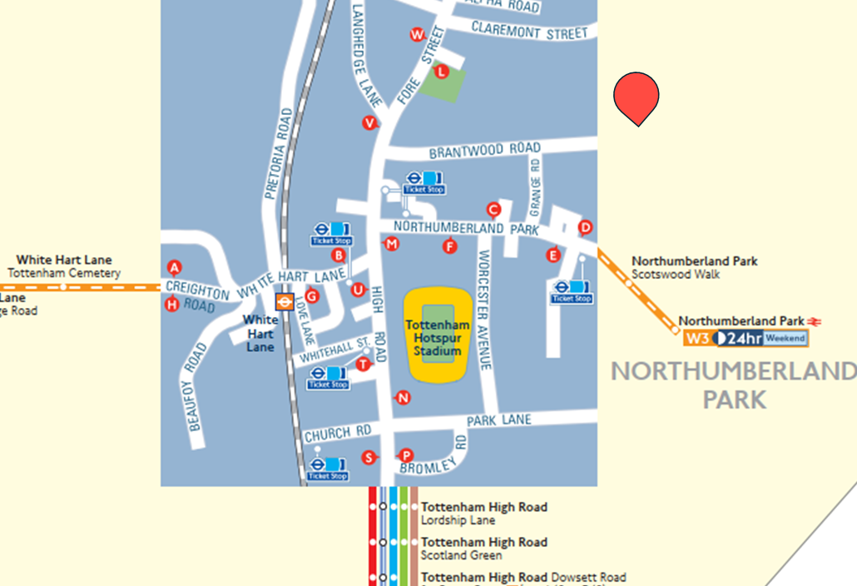

Local Bus Routes
For more information, click here.
Making Journeys by Bus:
Leeside Road Stop ‘NH’
Every 12 minutes
Upper Edmonton
Waterloo Station
341
Northumberland Park Stop ‘NA’
Every 10 minutes
Northumberland Park
King’s Cross Station
476
Scotswood Walk
Every 6 minutes
Finsbury Park Station
Northumberland Park
W3

Slide 8
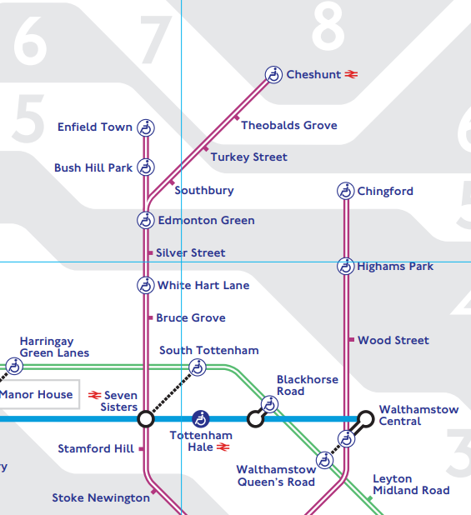
London Underground
Meridian Water
Located a 500m (8 minute) walk away, providing access to Greater Anglia services to Stratford, Bishops Stortford and Hertford East.
White Hart Lane
Located a 1.28km (17 minute) walk away, providing access to Weaver Line services to London Liverpool Street, Cheshunt and Enfield Town.
For more information, click here.

Slide 9

Driving
Car Clubs:
Members of car clubs have access to a car without the expense of ownership; Como UK estimate that car club users save £3,500 a year.
Car clubs include:
Drive-now
Hertz 24/7
Co-wheels
Car Sharing:
Car sharing is when two or more people share a journey to a particular destination e.g. to work.
Benefits can include:
Savings on travel and parking
Meeting new people
Helps to reduce pollution
Less stressful way to travel
Through Lift Sharing websites, drivers can advertise their journey and earn money by offering someone a spare seat in their car.

Slide 10
Local Schemes
Haringey Cycling Campaign
Haringey Cycling Campaign aims to promote cycling uptake for children and adults, whilst improving safe practices. The group offers community events and group rides as well as training sessions to grow cycling confidence.
Bike Week 2026:
Bike Week is delivered by Cycling UK and will run from the 9th-15th of June 2026. Thousands of people across the UK take part to enjoy the simple pleasure of riding a bike.
Walk to Work Day 2026:
National Walk to Work Day will take place on the 4th of April 2026 to help put people on track to a healthier lifestyle.
London Freedom Pass:
A travel pass for older people allows free use of buses, the tube and DLR networks in London between the hours of 8am and 10pm. More information can be found here.
Other Useful Apps and Websites:
City Mapper NextBuses National Rail Sustrans
Created by TTP Consulting

