Slide 1
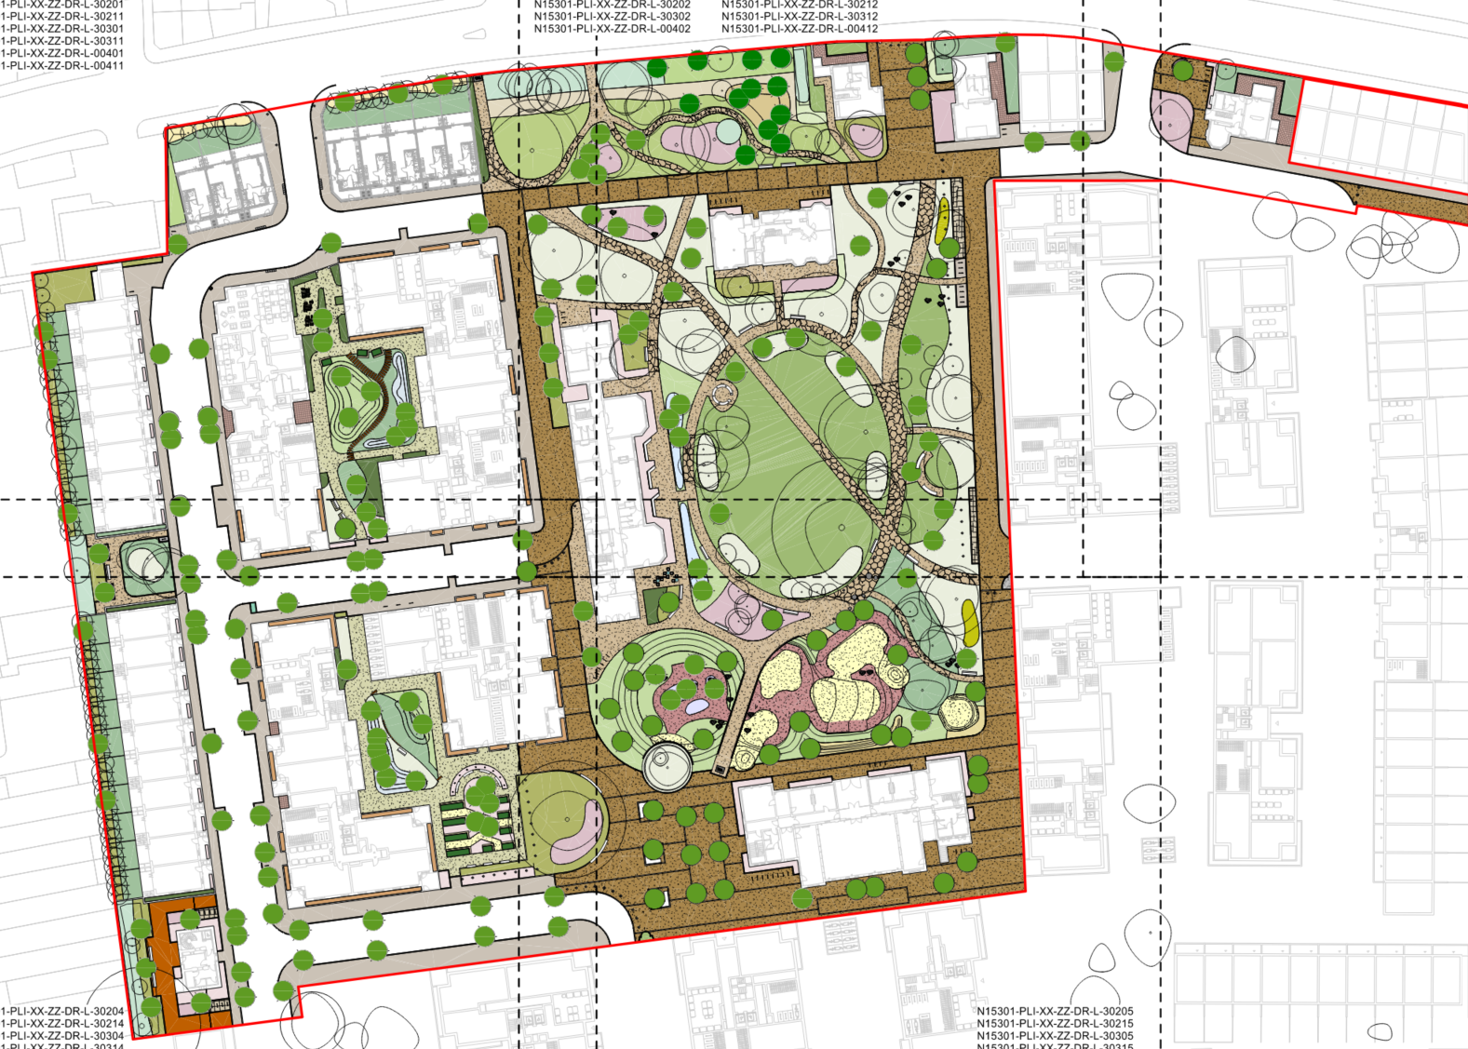
X026 – St Anns Landscape Presentation

Slide 2
X026 – St Anns Landscape Presentation
Condition 55
Notwithstanding the details submitted as part of the application, three months prior to the beginning of relevant works in Phase 1A, full details of hard and soft landscaping shall be submitted to and approved in writing by the Local Planning Authority. The details shall include:
i) Hard surfacing materials;
ii) Children’s play areas and equipment;
iii) Boundary treatments
iv) Any relevant SUDs features and associated SUDS management and maintenance plans, detailing future management and maintenance responsibilities for the lifetime of the development
v) Minor artefacts/structures (e.g. furniture, refuse or other storage units, signs etc.);
vi) Proposed and existing functional services above and below ground (e.g. drainage power, communications cables, pipelines etc. indicating lines, manholes, supports etc.);
vii) Planting plans and a full schedule of species of new trees and shrubs proposed to be planted noting species, plant sizes and proposed numbers/densities where appropriate;
viii) If T47 black mulberry is damaged during construction and associated works and needs to be removed this shall be replaced with a high quality tree of an appropriate size, standard and species;
ix) Written specifications (including cultivation and other operations) associated with plant and grass establishment; and
x) Implementation programme.
xi) Long term management
xii) Full details of wayfinding signage including their location, material and mounting (developed in consultation with the Council’s Regeneration team);
xiii) details of short stay parking to be provided in accordance with the London Cycle Design Standards.
xiv) existing and proposed land levels
* Items vi, viii, ix, x, xi, xii, xiii and xiv cannot be included in this presentation and has been explained/issued separately.

Slide 3


i) Hard surfacing materials - ST01 Carriageway

Slide 4

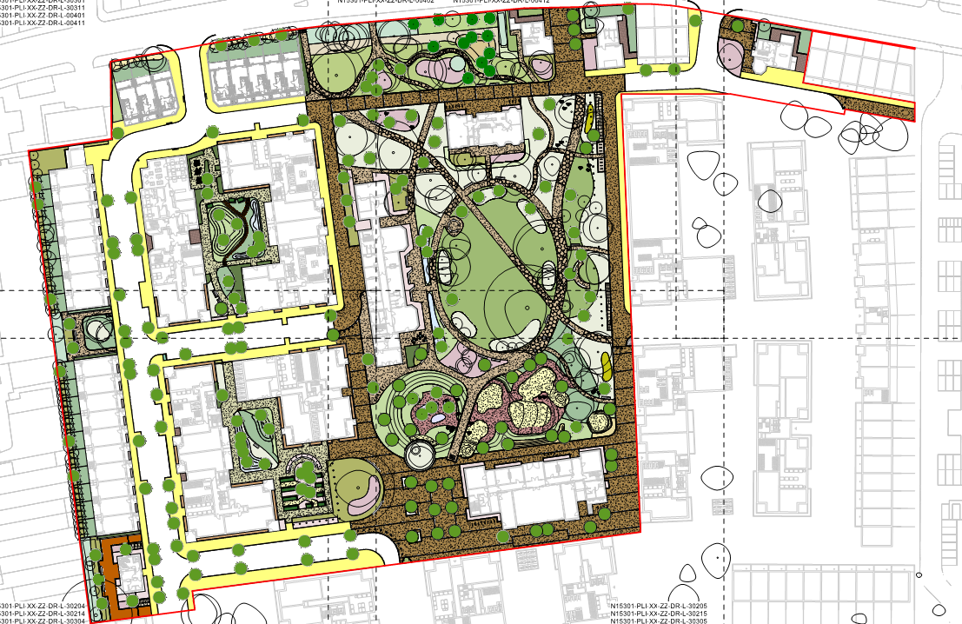
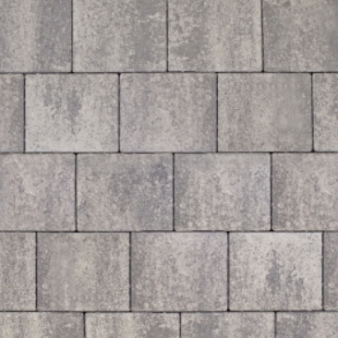
i) Hard surfacing materials ST02 – Footways

Slide 5
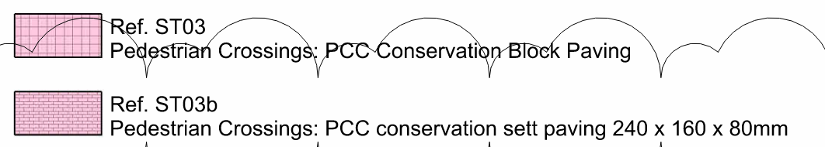
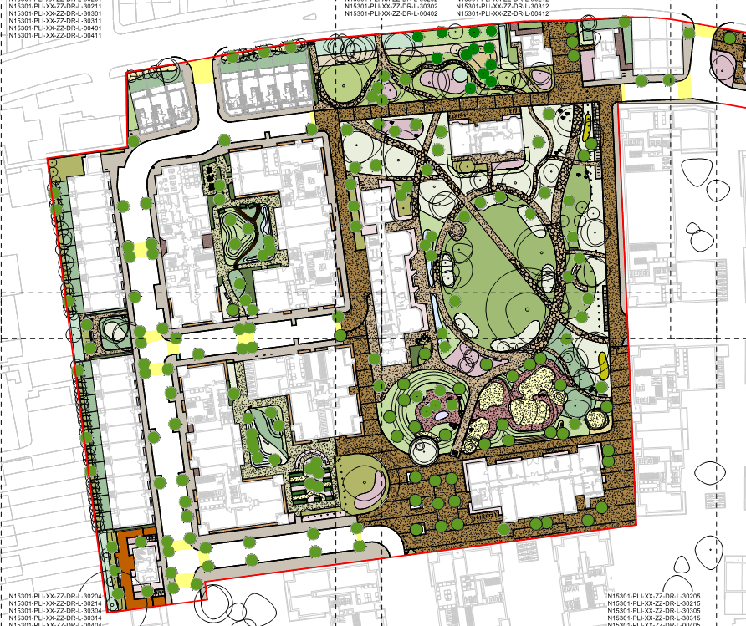
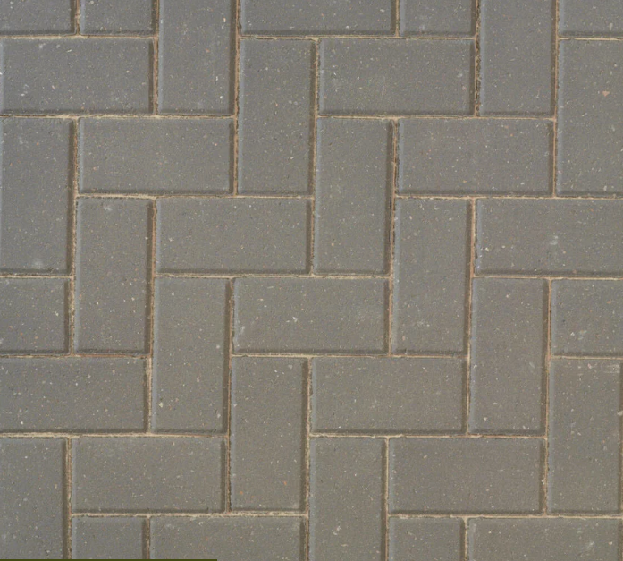
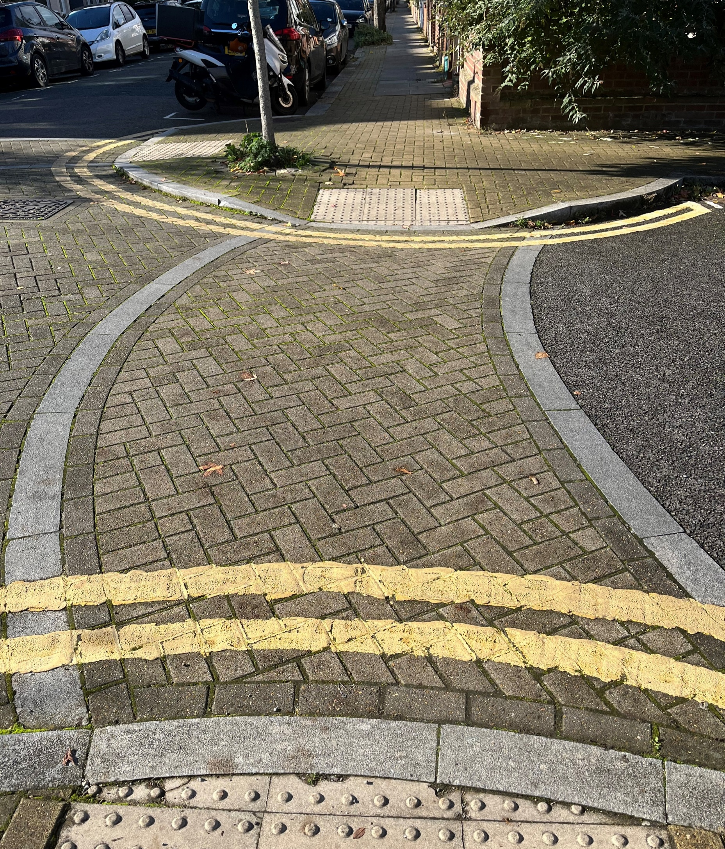
i) Hard surfacing materials - ST03 Pedestrian Crossings

Slide 6

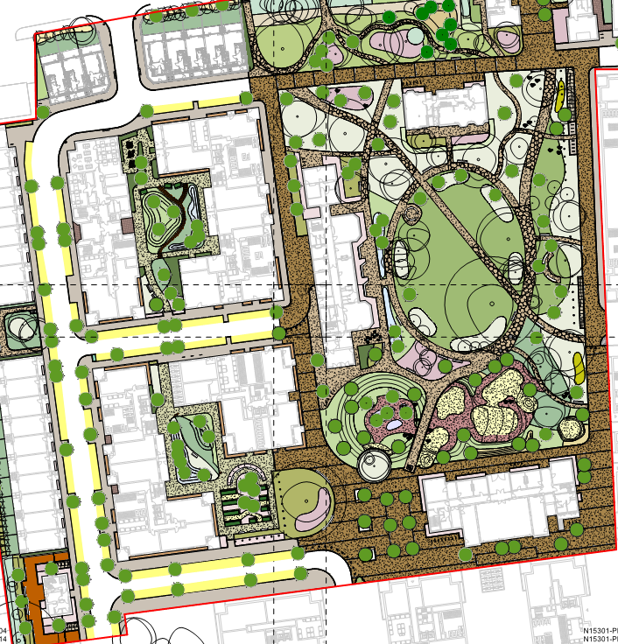
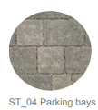
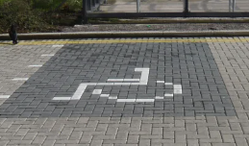
i) Hard surfacing materials - ST04a Parking Bays

Slide 7
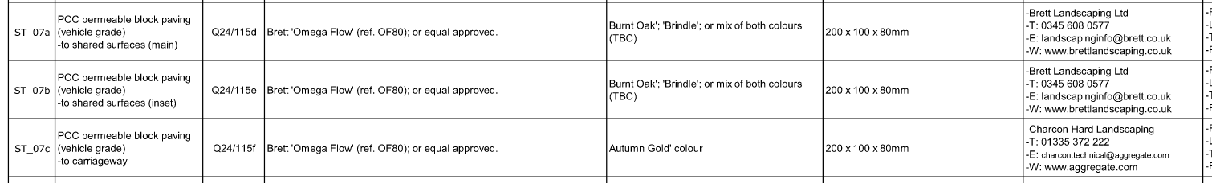
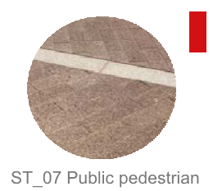
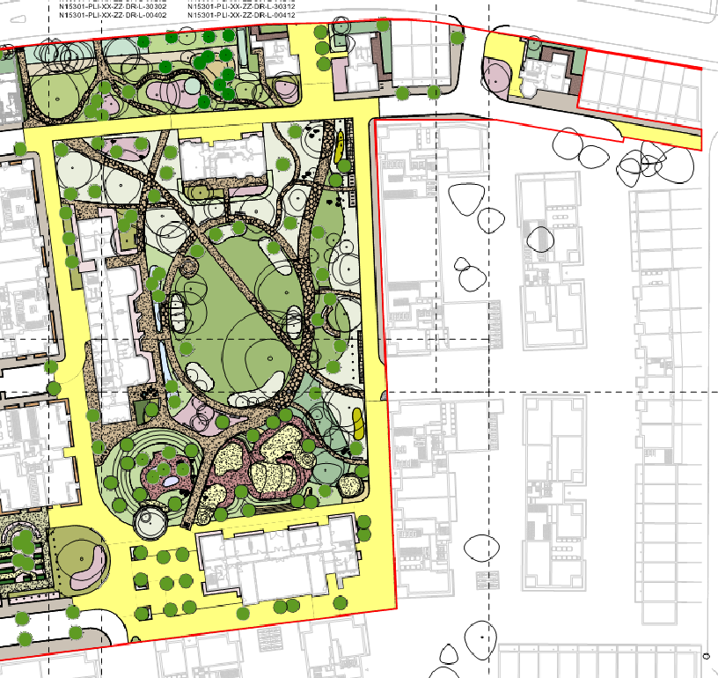
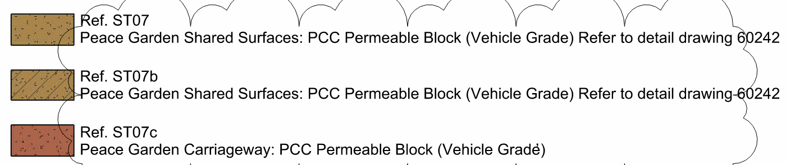
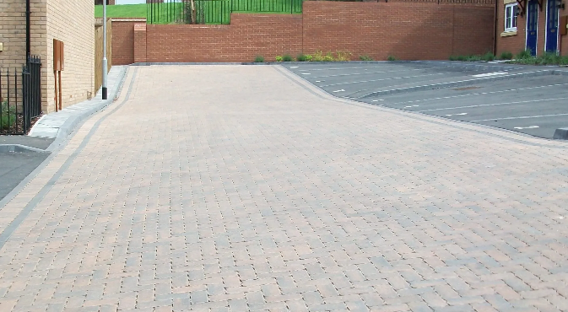
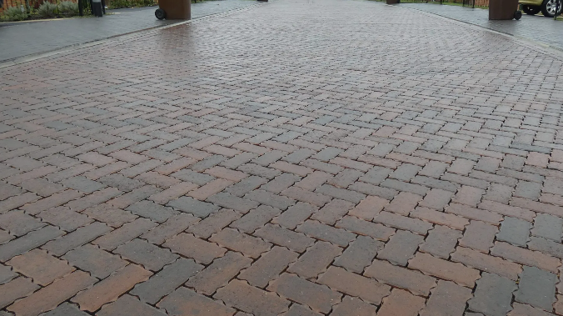
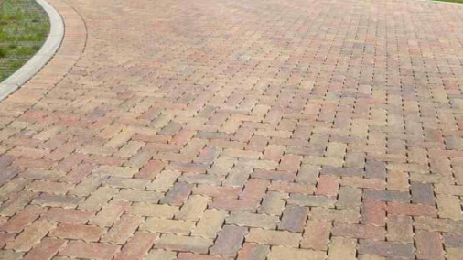
i) Hard surfacing materials - ST07 Concrete Paving
Burnt Oak
Brindle
Autumn Gold

Slide 8
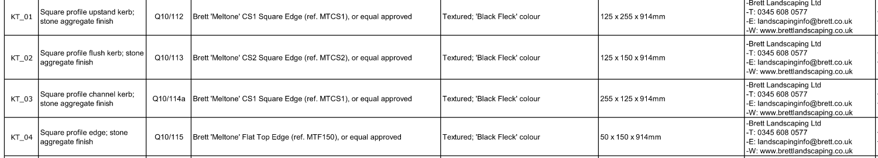
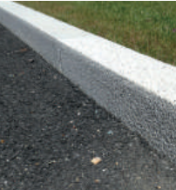
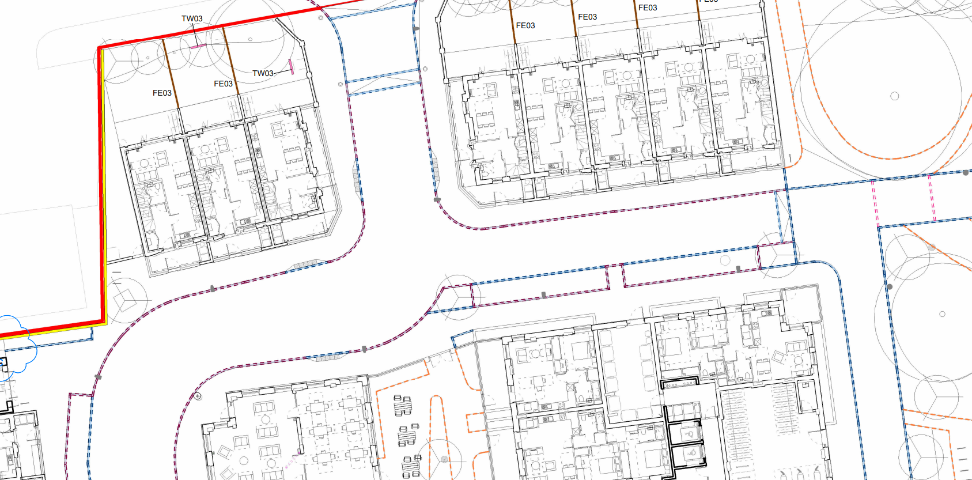
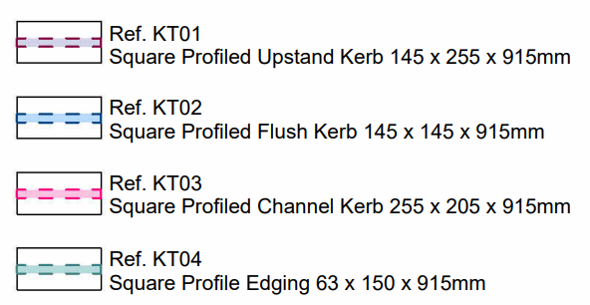
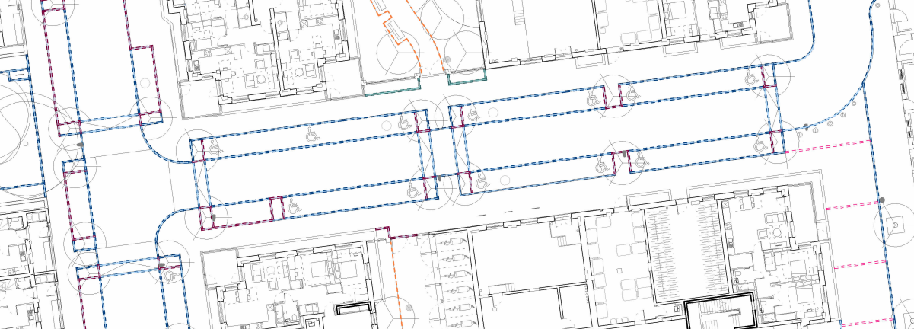
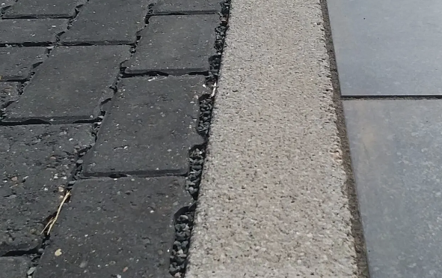
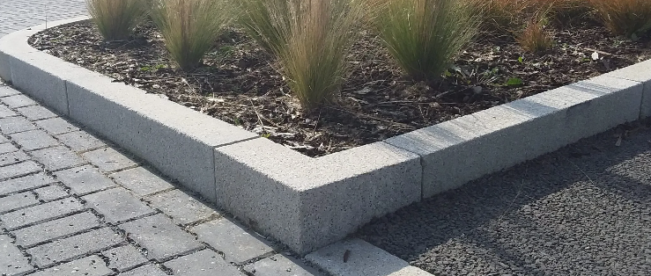
i) Hard surfacing materials KT01 – KT04 – Kerbs
125mm Upstand
Flush
Flush
25mm Upstand
KT04
KT02
KT01/KT03
Notes:
KT01 – 125mm upstands
KT02 – Flush
KT03 – Flush
KT04 – 25mm Upstand

Slide 9
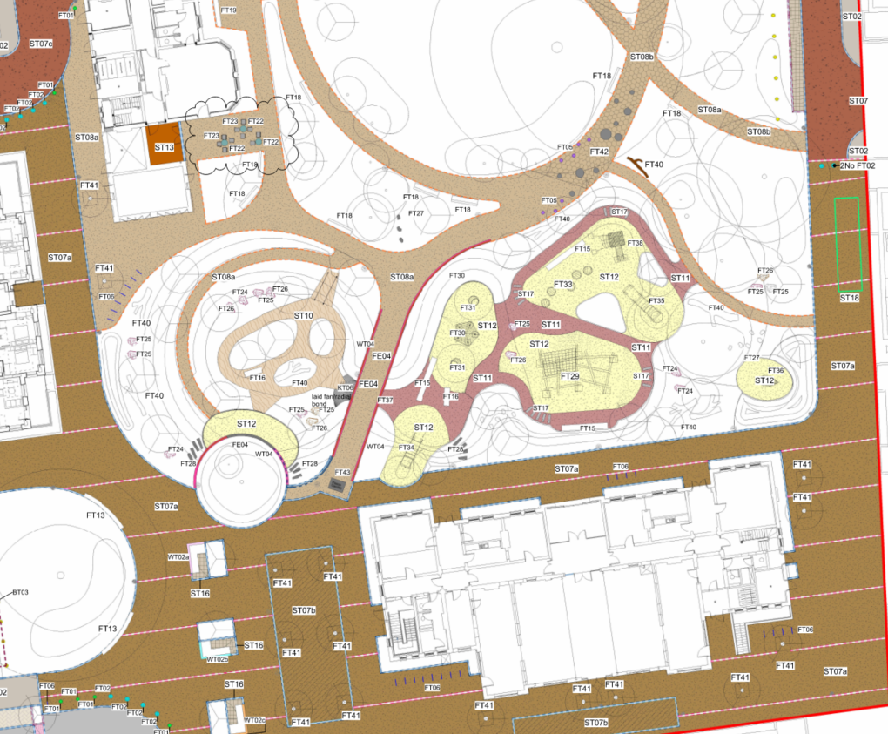
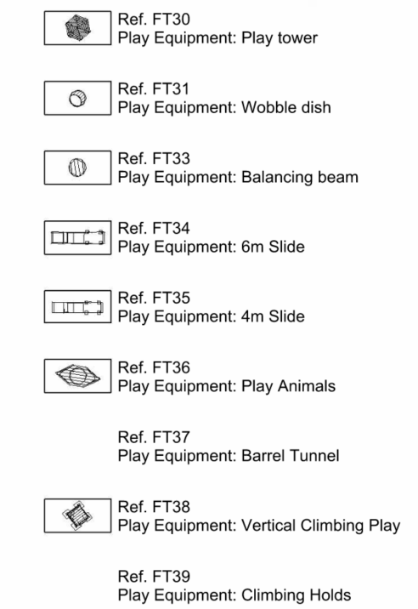

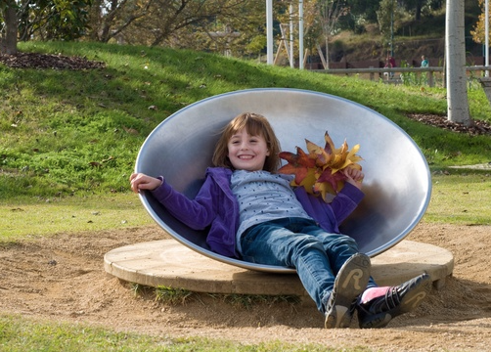
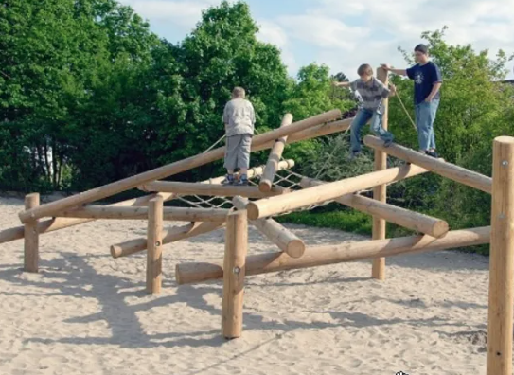
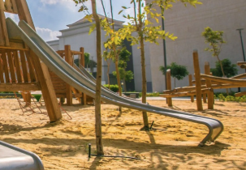
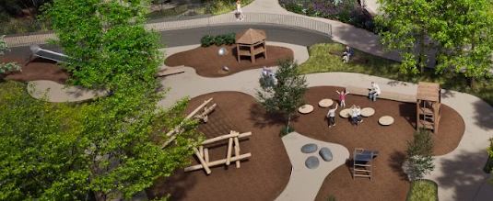
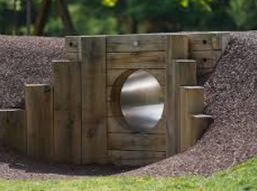
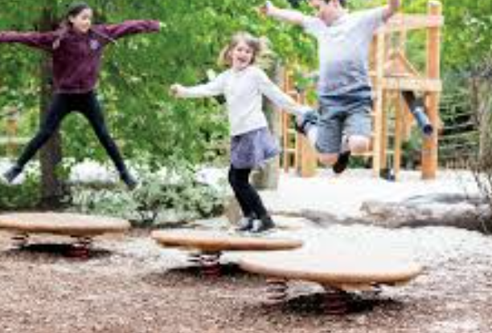
ii) Children’s play areas and equipment – Peace Garden
FT36
FT31
FT29
FT34-35
Illustrative Image
FT37
FT33
Notes:
KT01 – 125mm upstands
KT02 – Flush
KT03 – Flush
KT04 – 25mm Upstand

Slide 10
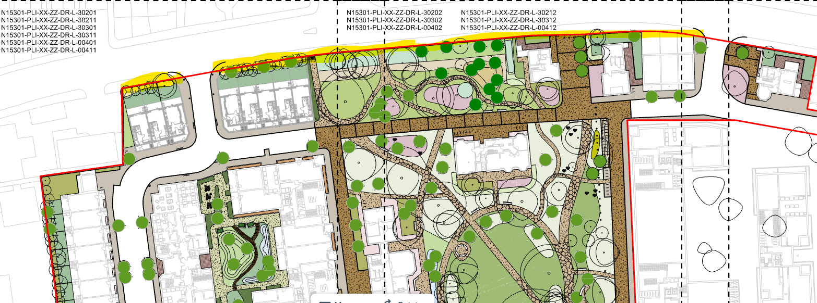
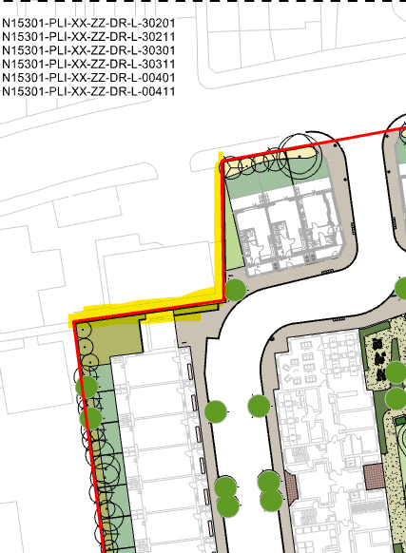
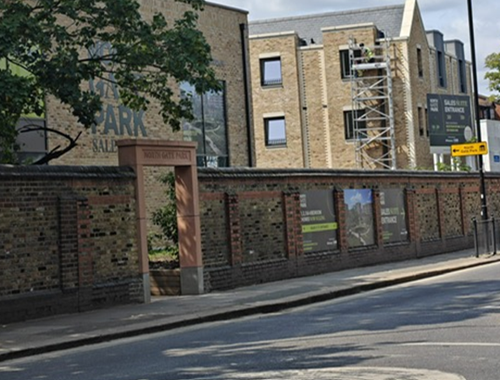
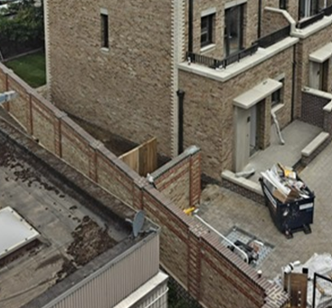
iii) Boundary treatments
Existing Wall with new openings
New Boundary Wall
Notes:
KT01 – 125mm upstands
KT02 – Flush
KT03 – Flush
KT04 – 25mm Upstand

Slide 11
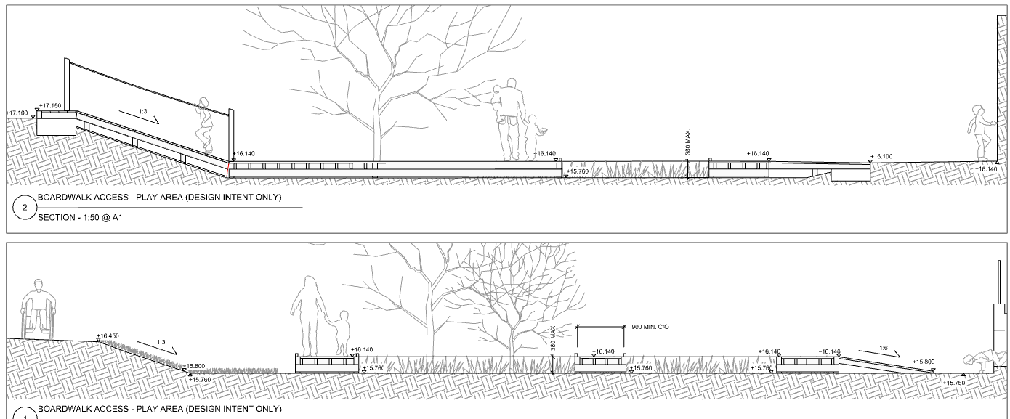
iv) SUDs features
Causeway provided to the South-West area of the Peace Garden, a Boardwalk designed also to the same area when the causeway is wet.
Notes:
KT01 – 125mm upstands
KT02 – Flush
KT03 – Flush
KT04 – 25mm Upstand

Slide 12
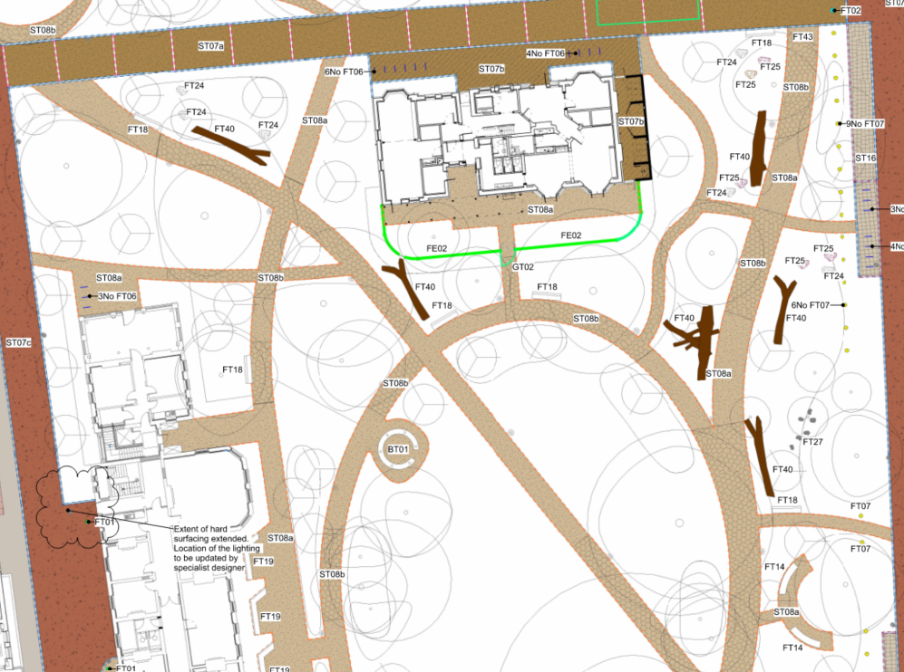
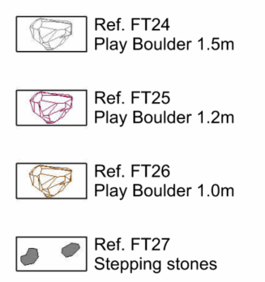
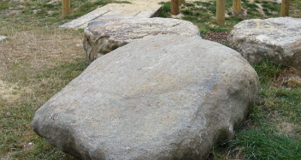
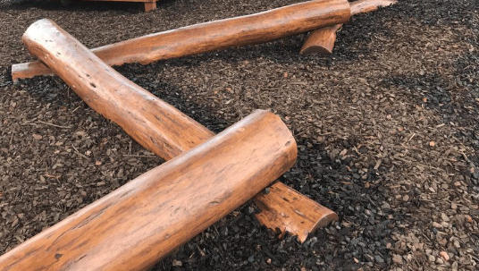

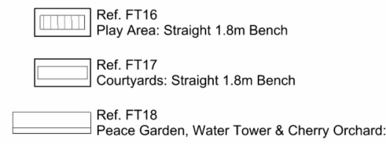
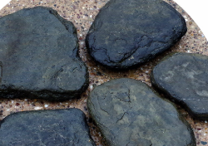
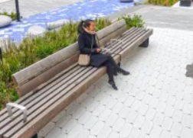
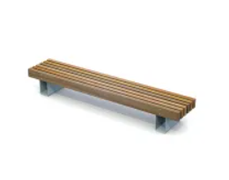
v) Minor artefacts/structures – Peace Garden
FT24-26
FT40
FT27
FT16
FT17
Notes:
KT01 – 125mm upstands
KT02 – Flush
KT03 – Flush
KT04 – 25mm Upstand

Slide 13
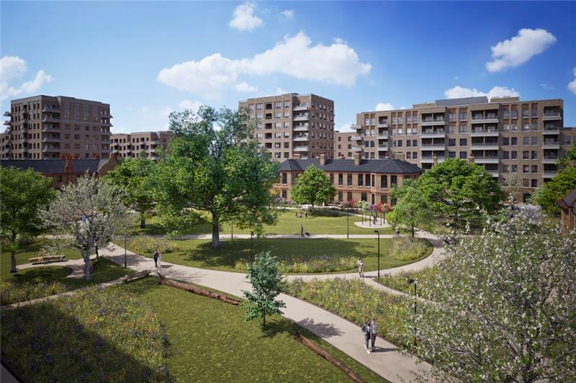
vii, ix) Planting Plans & Species – Peace Garden
Illustrative Image
Notes:
KT01 – 125mm upstands
KT02 – Flush
KT03 – Flush
KT04 – 25mm Upstand

Slide 14
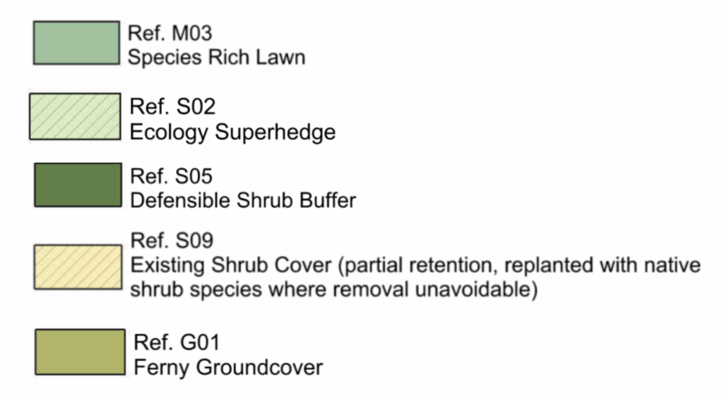
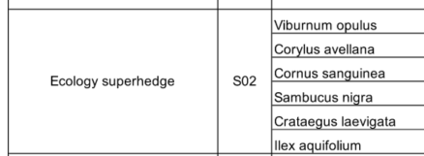
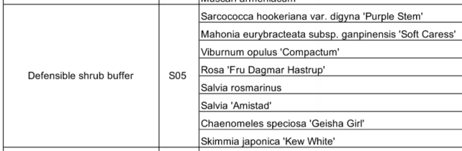
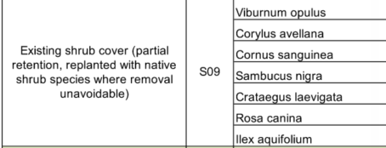







vii, ix) – Private Gardens to Houses
G01
S02
S05
M03
Notes:
KT01 – 125mm upstands
KT02 – Flush
KT03 – Flush
KT04 – 25mm Upstand

Slide 15







vii, ix) Planting Plans & Species – Peace Garden
M01
M02
B01
R01
B02
Notes:
KT01 – 125mm upstands
KT02 – Flush
KT03 – Flush
KT04 – 25mm Upstand

Slide 16





vii, ix) Planting Plans & Species – Peace Garden
R03
M02
M03
S06
B01
R01
S06
B02
Notes:
KT01 – 125mm upstands
KT02 – Flush
KT03 – Flush
KT04 – 25mm Upstand

Slide 17












vii) Planting Plans & Species – Proposed / Existing Trees - Peace Garden
P32
Existing Tree
Existing Tree
P18
P24
P25
P31
P27
Notes:
KT01 – 125mm upstands
KT02 – Flush
KT03 – Flush
KT04 – 25mm Upstand

Slide 18




vii) Planting Plans & Species - Courtyard
M01
M02
B02
S05
G02
G03
Notes:
KT01 – 125mm upstands
KT02 – Flush
KT03 – Flush
KT04 – 25mm Upstand

